Slide 1
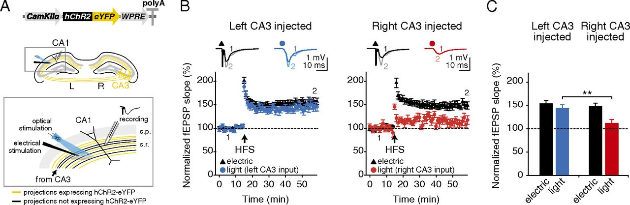

High-frequency stimulation-induced LTP is asymmetrically expressed at the CA3–CA1 pyramidal cell synapse.
Olivia A. Shipton et al. PNAS 2014;111:42:15238-15243
©2014 by National Academy of Sciences
Notes:
High-frequency stimulation-induced LTP is asymmetrically expressed at the CA3–CA1 pyramidal cell synapse. (A, Upper) Adeno-associated virus containing hChR2-eYFP construct under the control of a CaMKIIα promoter was unilaterally injected into the dorsal CA3 area of C57BL/6J mice. (Lower) An electrode to deliver nonselective electrical stimulation was placed in the stratum radiatum and a high-power 470-nm LED was arranged to recruit an overlapping population of projections. Optical stimulation only recruits projections originating in the CA3 of the injected hemisphere (yellow), whereas electrical stimulation is nonselective (black and yellow). Electrical stimulation was used to deliver the high-frequency LTP induction protocol and the effects were monitored via field recording of EPSPs evoked by electrical or optical stimulation. (B) HFS produces robust LTP in the electrical pathway (black triangles), but LTP is only expressed in the optical pathway (circles) when projections originate in the left CA3. (Insets) Representative field EPSPs at the indicated time points (1, 2). (C) Significantly more LTP is observed in left-injected mice than in right-injected mice in the optical pathway. Broken lines represent baseline. Error bars represent SEM. **P < 0.01, Student’s t test.

